Slide 1



Slide 2
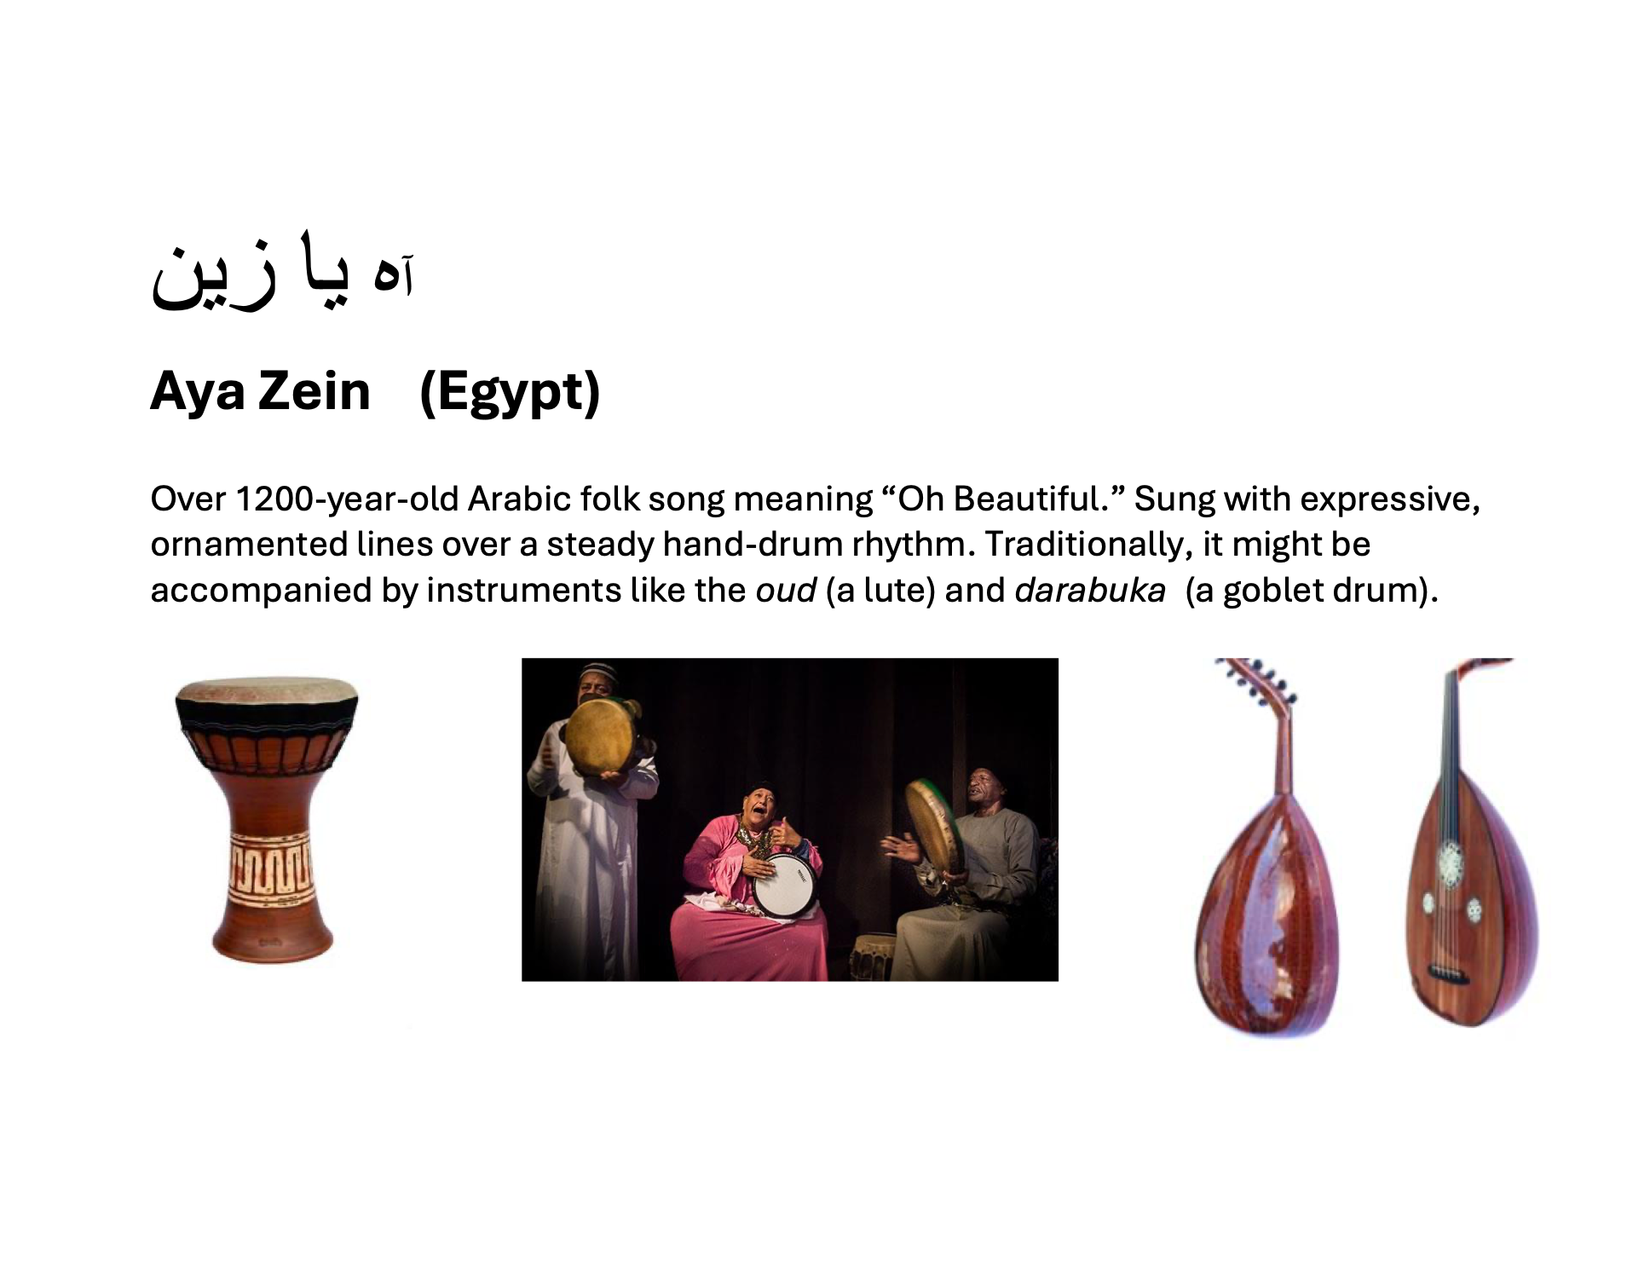

Slide 3
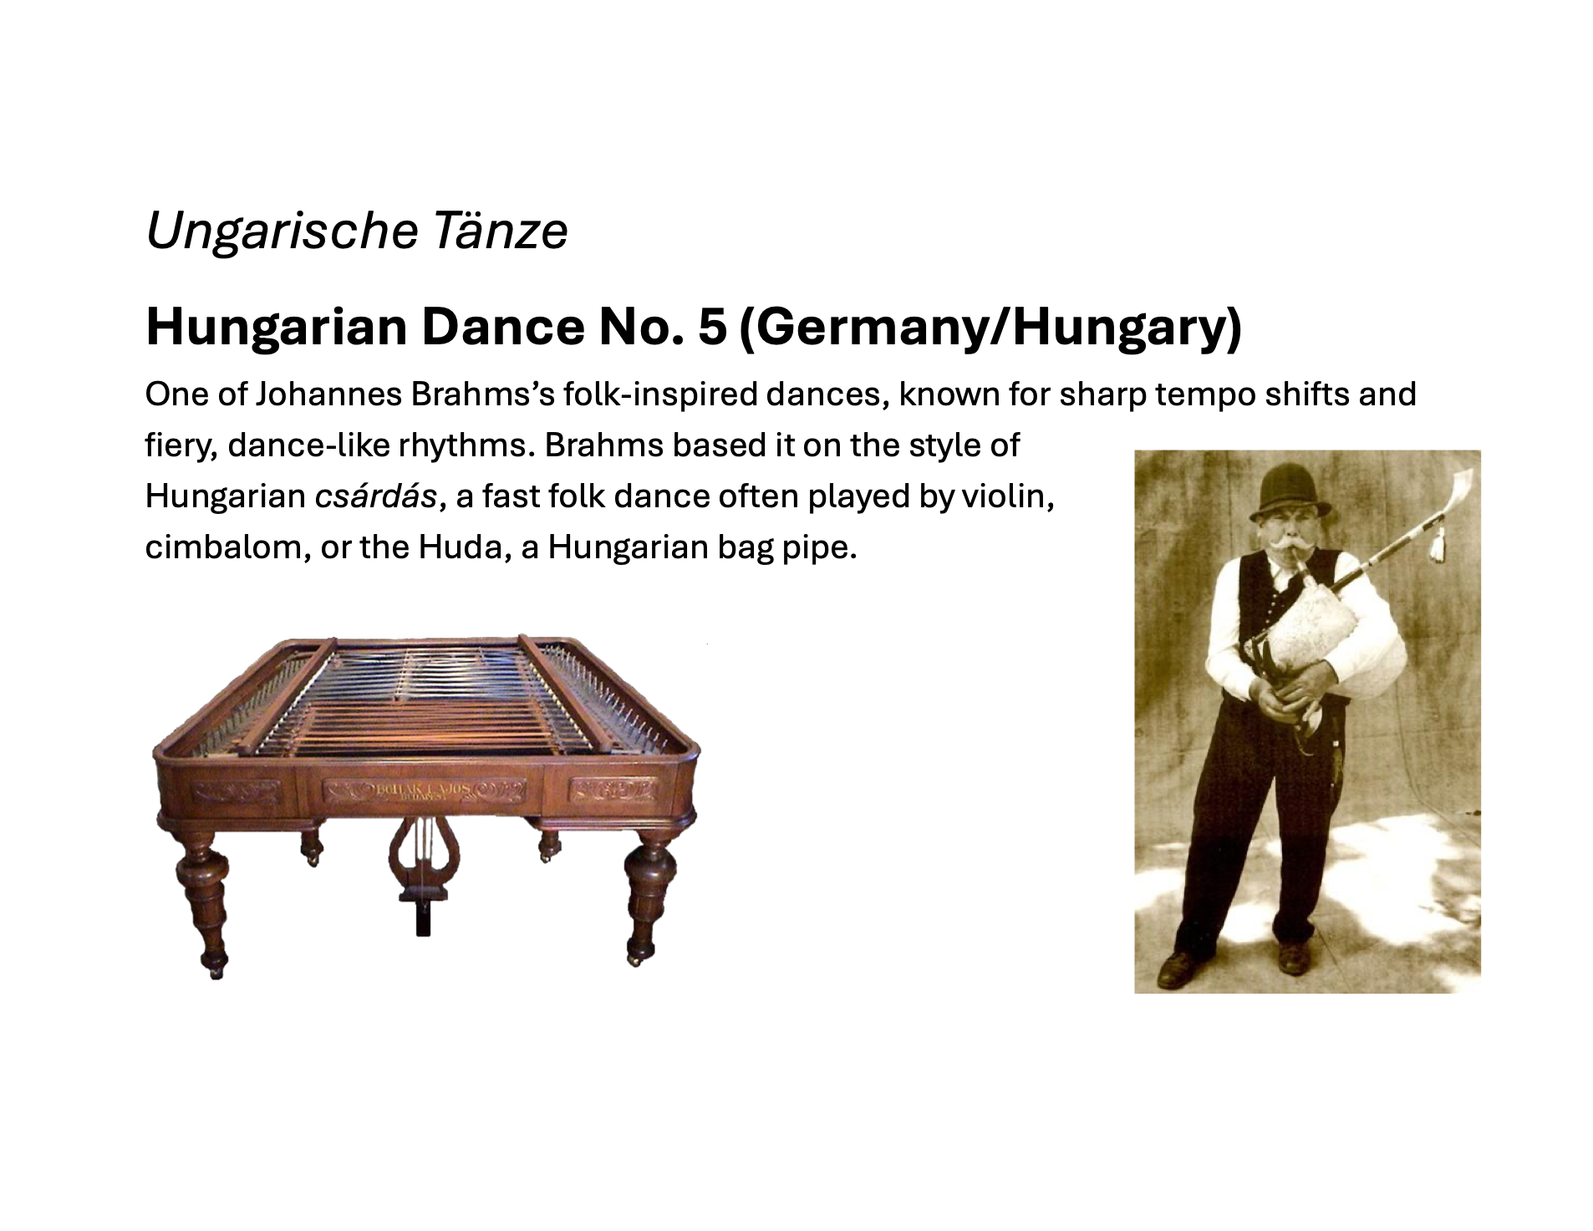

Slide 4
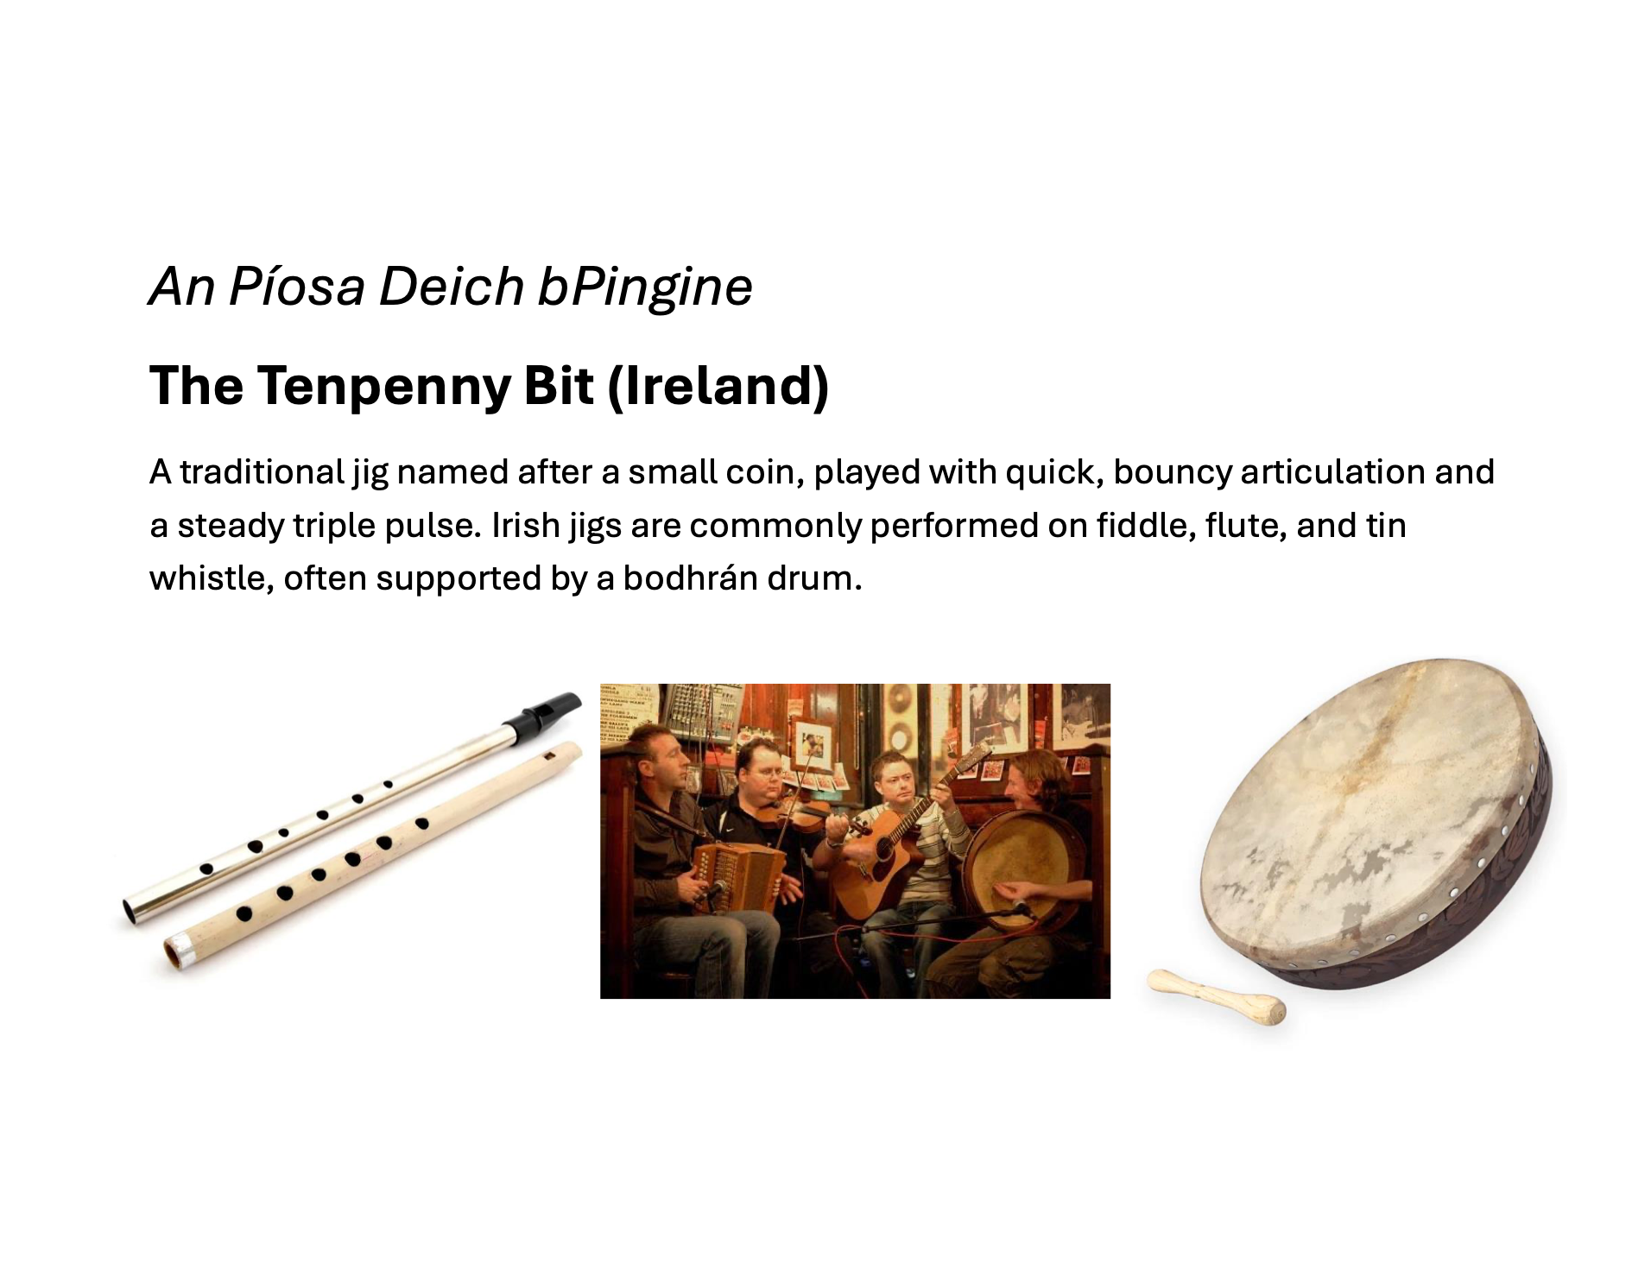

Slide 5
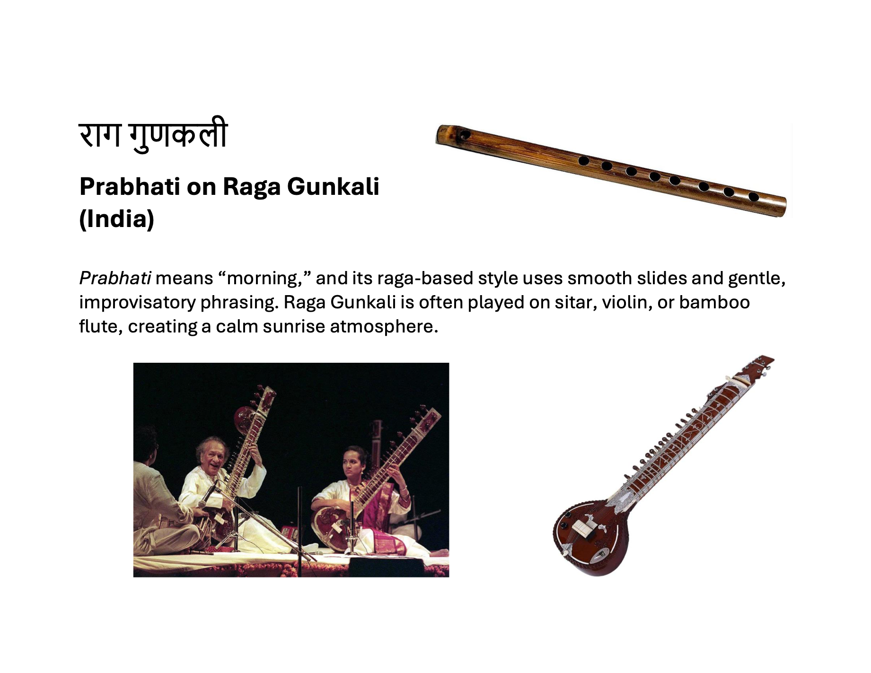

Slide 6
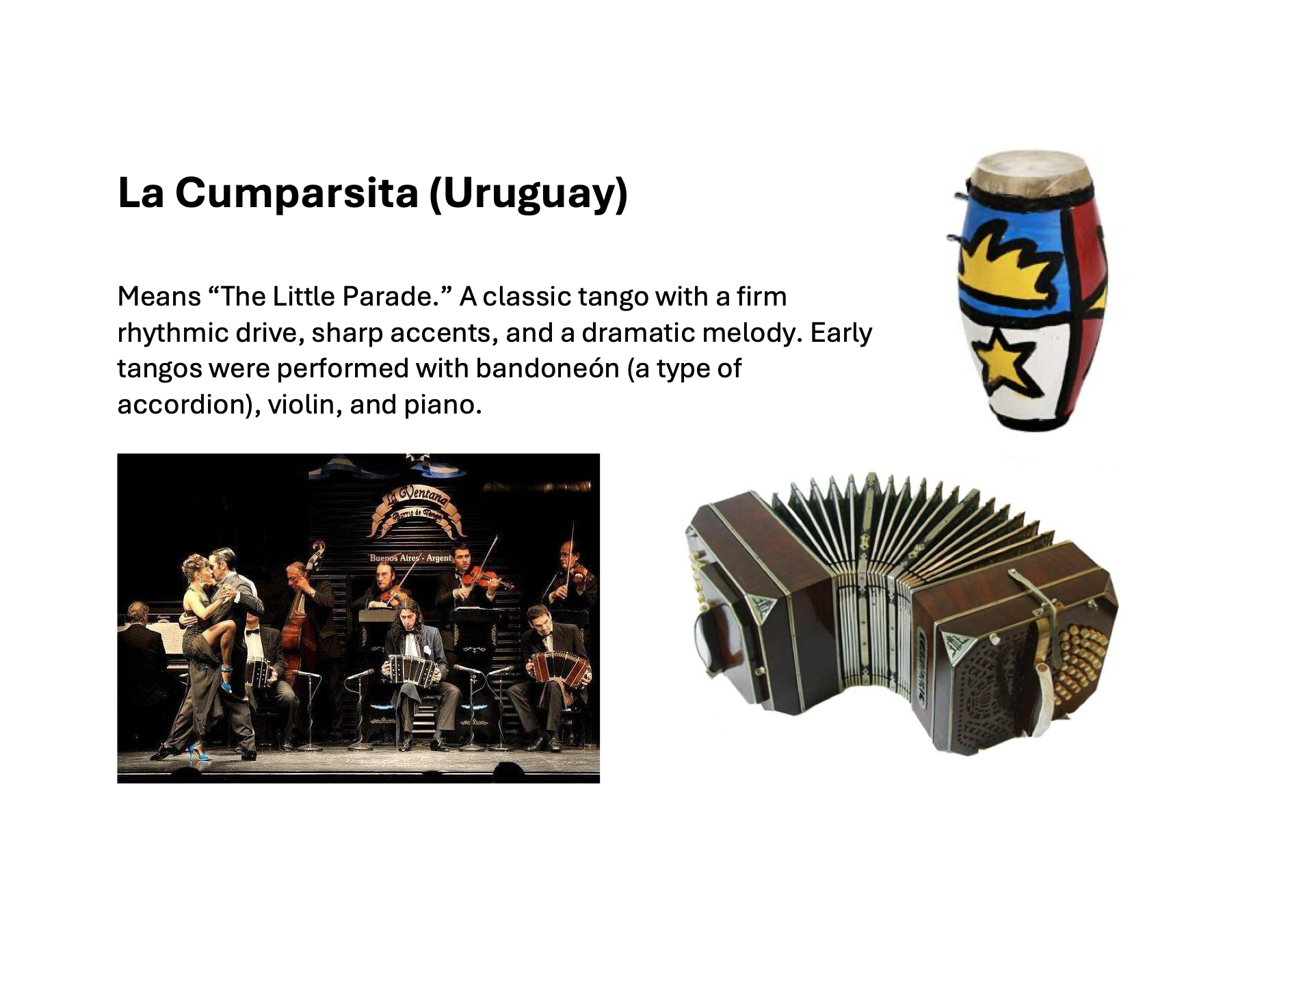

Slide 7
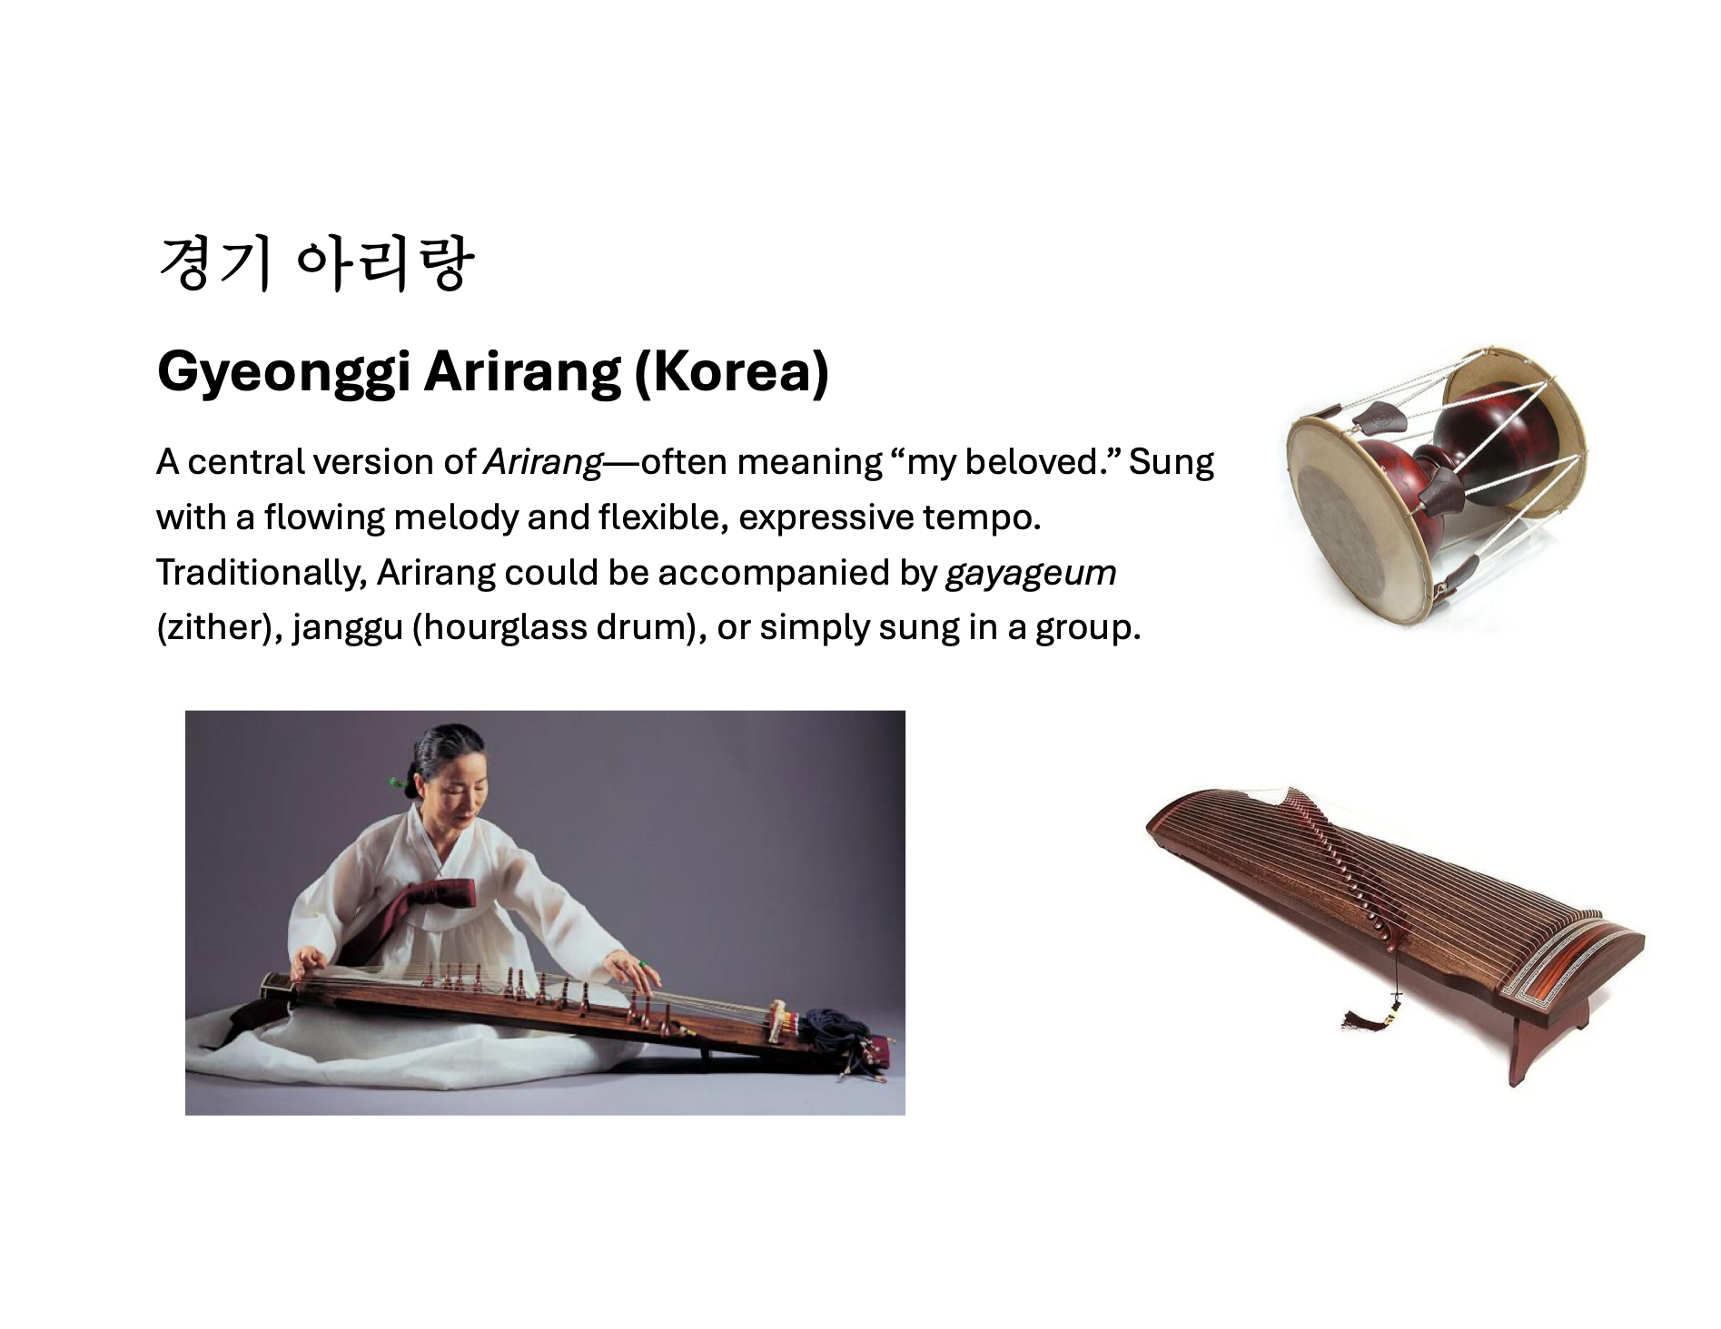

Slide 8
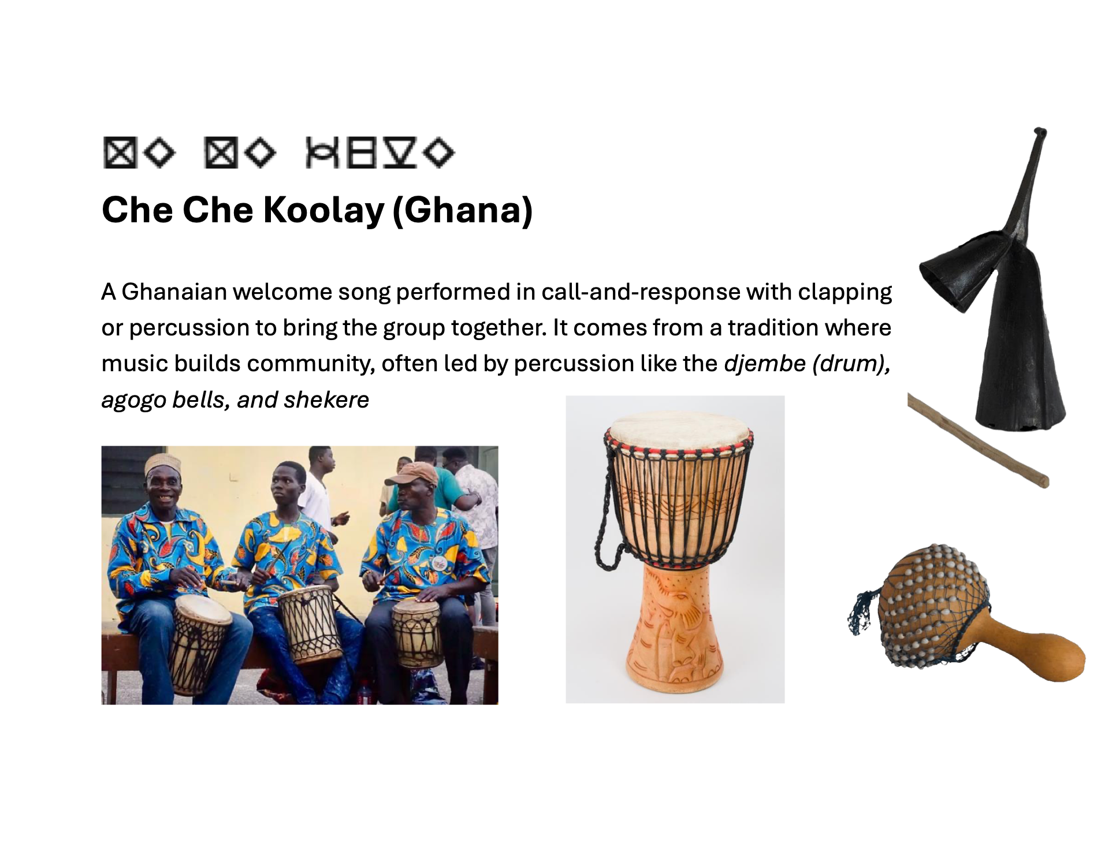

Slide 9
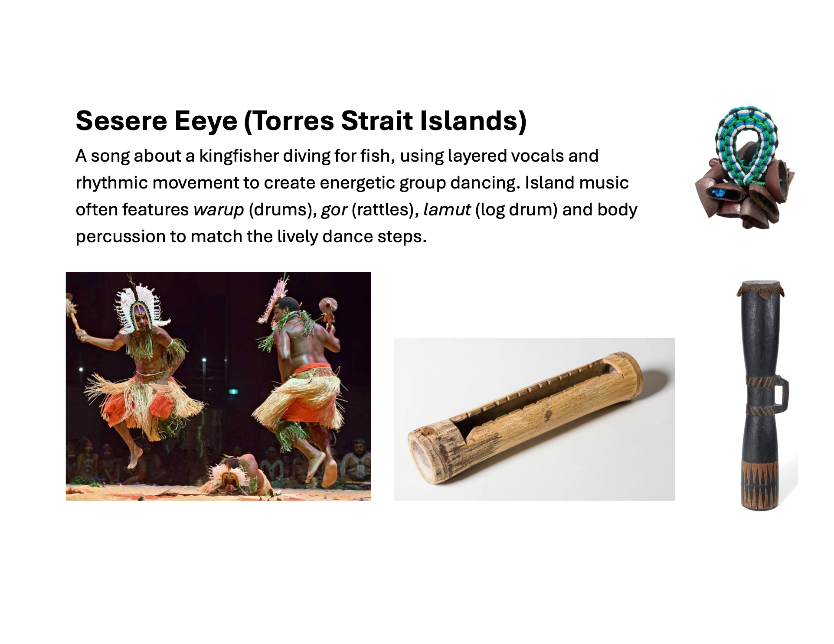

Slide 10
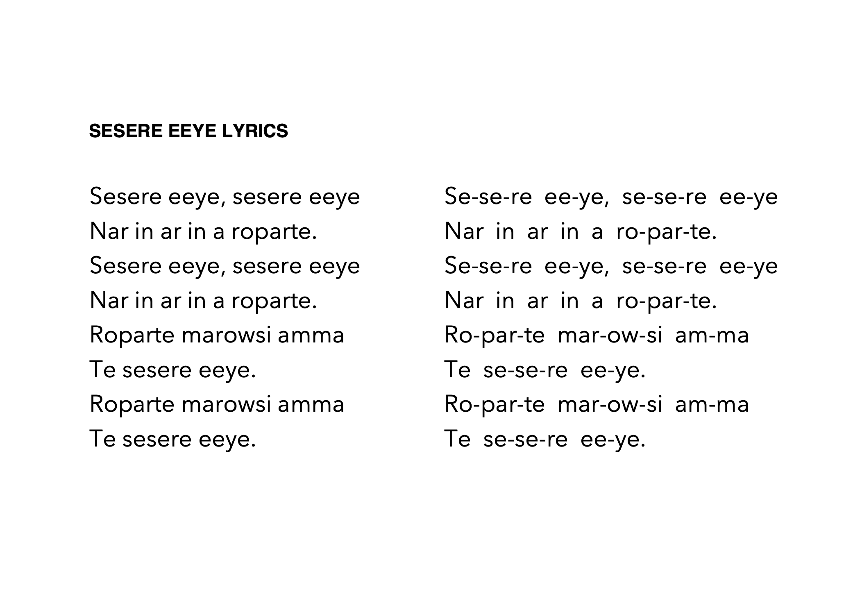

Slide 12
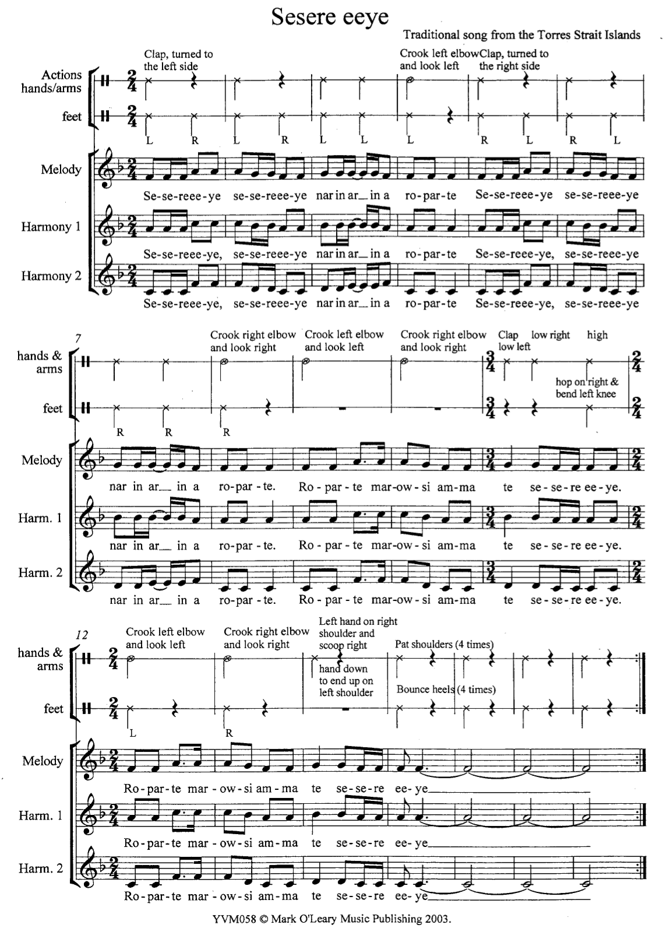

Slide 13
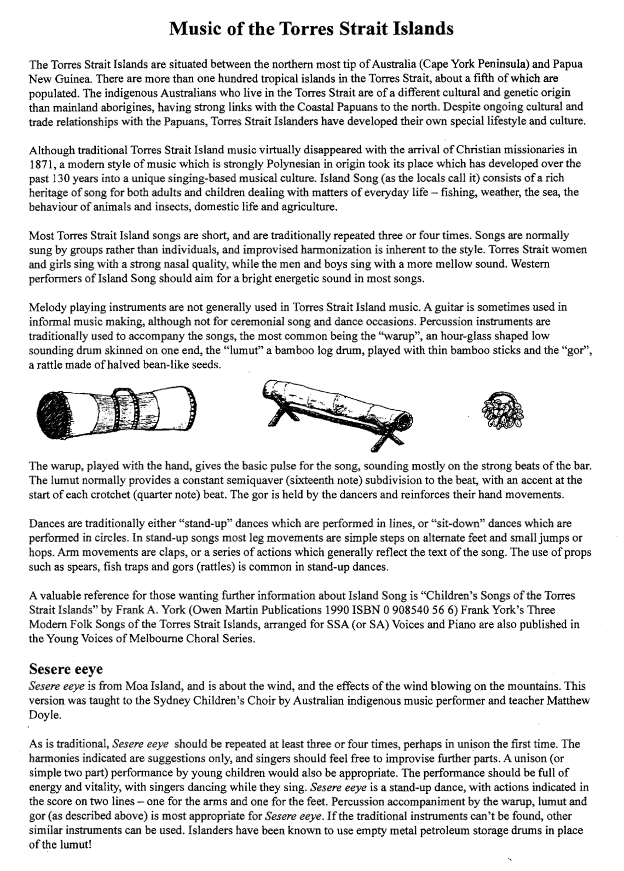

Slide 14
STRINGS Around The World 2026
CONCERT PROGRAM
The London Symphonia String Quintet
Joe Lanza, violin
Émilie Paré, violin
Kelvin Enns, viola
Ben Bolt-Martin, cello
Joe Phillips, bass
Host: Scott Good, Composer-in-Residence and Head, School Education Programs
Welcome
Scott Good

Slide 15
Aya Zein (Egypt)
Over 1200-year-old Arabic folk song, which means “Oh Beautiful.” Sung with expressive, ornamented lines over a steady hand-drum rhythm.
Hungarian Dance No. 5 (Germany/Hungary)
One of Johannes Brahms’s folk-inspired dances, known for sharp tempo shifts and fiery, dance-like rhythms.
The Tenpenny Bit (Ireland)
A traditional jig named after a small coin, played with quick, bouncy articulation and a steady triple pulse.
Prabhati on Raga Gunkali (India)
Prabhati means “morning.” Its raga-based style uses smooth slides and gentle, improvisatory phrasing.

Slide 16
La Cumparsita (Uruguay)
Means “The Little Parade.” A classic tango with a firm rhythmic drive, sharp accents, and a dramatic melody.
Gyeonggi Arirang (Korea)
A central version of Arirang—often meaning “my beloved.” Sung with a flowing melody and flexible, expressive tempo.
Che Che Koolay (Ghana)
A Ghanaian welcome song performed in call-and-response with clapping or percussion to bring the group together.
Sesere Eeye (Torres Strait Islands)
A song about a kingfisher diving for fish, using layered vocals and rhythmic movement to create energetic group dancing.
Finale Sing Along – Sesere Eeye

